Slide 1

DVA - TEAM 14
DELIVERABLES
PRESENTED BY ACTIVE MEMBERS:
Sakshitha K
Laiba Jawaid
Faiza Javed
Chaitanya Jori
Bharadwaj K
Submitted on: 1st September 2025

Slide 2

INTRODUCTION
Four-week experiential program replicating a real-world data
analytics workflow.
Covered the complete data lifecycle: exploration,
cleaning, transformation, visualization, and presentation.
Worked with multi-source datasets to address challenges
like missing values, and duplicates, etc.
Gained experience in both technical analysis and business
relevance, and useful insights for stakeholders.

Slide 3
PROJECT SCOPE & DELIVERABLES
Scope covered data preparation, transformation, and visualization.
Conducted EDA to identify key patterns and anomalies.
Built a unified Master Table using ETL, followed by Mapping Tables and wireframes for KPIs and metrics.
Dashboard for visualization.
Final Deliverables:
Cleaned Master Table (49K+ unique learners)
Interactive Looker Studio dashboard
Comprehensive presentation with findings & recommendations

Slide 4
WEEK 1 – DATA UNDERSTANDING, EDA, AND CLEANING
DATASETS OVERVIEW
Datasets used: Learner’s Data, Opportunity Data, CohortRaw Data, Marketing Data,
Learner Opportunity Data, Cognito Data
DATA FAMILIARIZATION
Common Issues:
  Missing values
  Duplicate risks
  Inconsistent formatting
  Biases - Geographic skew self-reported errors

Slide 5
EDA Highlights (Visual & Stats)
Geographic Trends: Learners concentrated in India, Nigeria, Pakistan
Education Trends: STEM (esp. Computer Science & Engineering) dominate
Cohort Analysis: Sizes vary from 1k to 100k; overlapping timelines
Cognito Data: 33% missing in demographics (gender, city, state,
birthdate, zip)
Marketing Data:
  Reach max: 141M+, Avg: 1.7M
  Duplicates: 12 rows detected

Slide 6
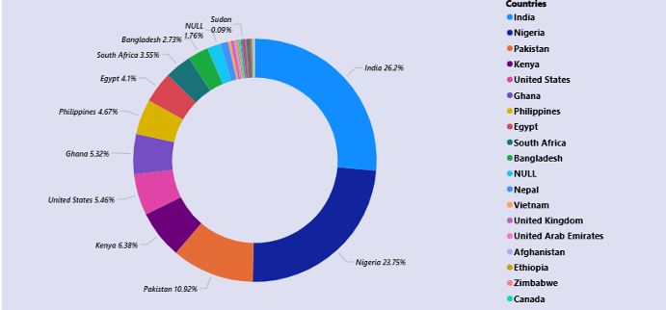
DONUT CHART (FROM LEARNER DATASET)
What it shows:
Geographic distribution of learner from India, Nigeria, and Pakistan, while other countries have smaller shares.
Why it was created:
To highlight the geographic bias in the dataset.

Slide 7
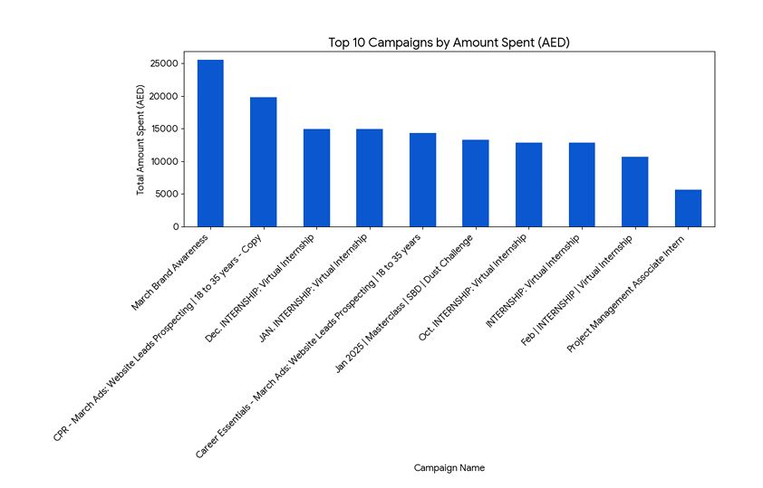
BAR CHART: (MARKETING DATASET)
What it shows:
Total spending across marketing campaigns.
Why it was created:
To identify where resources were heavily allocated high spending actually led to
better campaign results.

Slide 8
WEEK 2 – MASTER TABLE DESIGN
PURPOSE:
To create a single, unified Master Table that serves as the central source of truth for all learner’s, ensuring data consistency and accuracy for reporting and dashboards.
DATASETS USED:
Learner Data, Cohort Data, Opportunity Data, Cognito Data & Learner_Opportunity (As a Bridge
table - For Joins)
EXCLUSION: Marketing Campaign Dataset was not merged because it was a separate Ad Campaigns data, not linked to learner’s schema.

Slide 9
DATA TRANSFORMATION AND ETL PROCESS
DATA CLEANING & ADJUSTMENTS FOR JOINS:
Removed Invalid Data: Eliminated entirely null rows and exact duplicate while preserving meaningful entries.
Standardized Formats: Ensured consistency by standardizing date formats into proper types and text casting across all datasets.
Aligned Key Identifiers: Aligned critical IDs (Learner_ID, Opportunity_ID, Cohort_ID) across all tables.
Merged and Validated: To create a unified Master Table, followed by validation to ensure data accuracy and completeness.

Slide 10
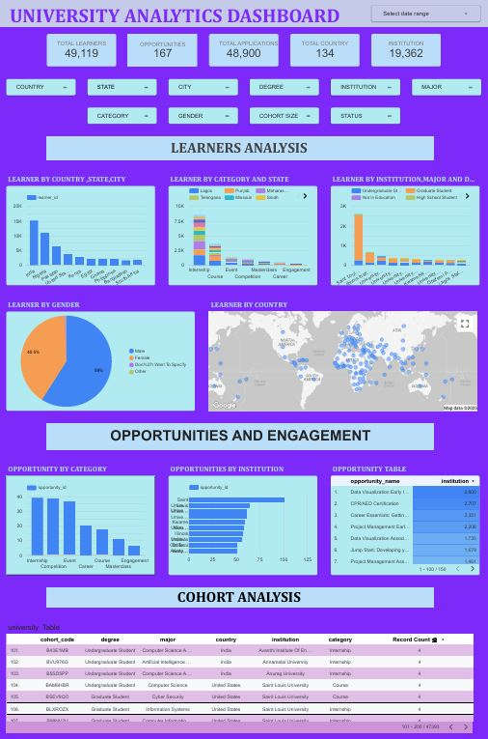
MASTER TABLE DATA INSIGHTS
Here the data's presented in one combined
view, the dashboard's organized into distinct
sections and this lets us showcase insights
from different categorized datasets all in
one place.

Slide 11
WEEK 3 SUMMARY
MAPPING TABLE
The mapping table defines how raw data maps to dashboard fields, ensuring
clarity for ETL and visualization teams.
KPIs: Learner_id, Cohort_size, status.
Includes metrics and filters/Dimensions.
Ensures data lineage, ETL guidance, and standardized
formats.
Outcome: The mapping table documents data flow and ensures
consistent ETL transformations and accurate dashboard KPIs/filters.

Slide 12
WIREFRAME DESIGN
KPI Layer: A high-level performance snapshot for executives and displays high-level metrics for quick insights.
Graphs Layer: Detailed charts for operational insights into learners and opportunities.
Comparative Layer: Interactive filters and cross-dimensional analysis uncover trends and relationships.
Cohort Analysis & Cross-Analysis
Focuses on learner participation over time.
Provides multi-dimensional insights.

Slide 13
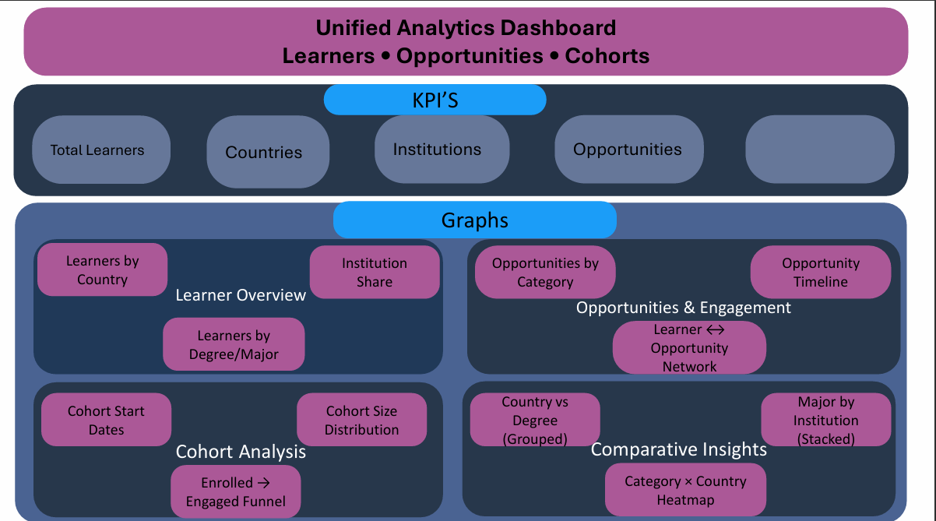

Slide 14
WEEK 4 SUMMARY
DASHBOARD CREATION
Created Looker Studio dashboards for analyzing master table data.
Built interactive dashboards for tracking marketing data performance and ROI.
Master Table Dashboard
Data Collection and Data Processing
Dashboard Creation
KPIs: Total learners, total institutions, opportunities, countries, avg cohort size.
Visuals: World map, Bar chart, Funnel chart & Comparative charts

Slide 15
VISUALIZATION OF MASTER TABLE GLOBAL VIEW
World Map – Learners by Country
Highest in India, Nigeria and USA.
Bar Chart – Top Institutions
Enrollment is Highest at SLU and Kwame Nkrumah University.
Funnel – Cohort Engagement
High Cohort Enrolment but Low Cohort Engagement.
Stacked/Grouped Bar – Major vs Country/Institution
High in India & Nigeria.

Slide 16
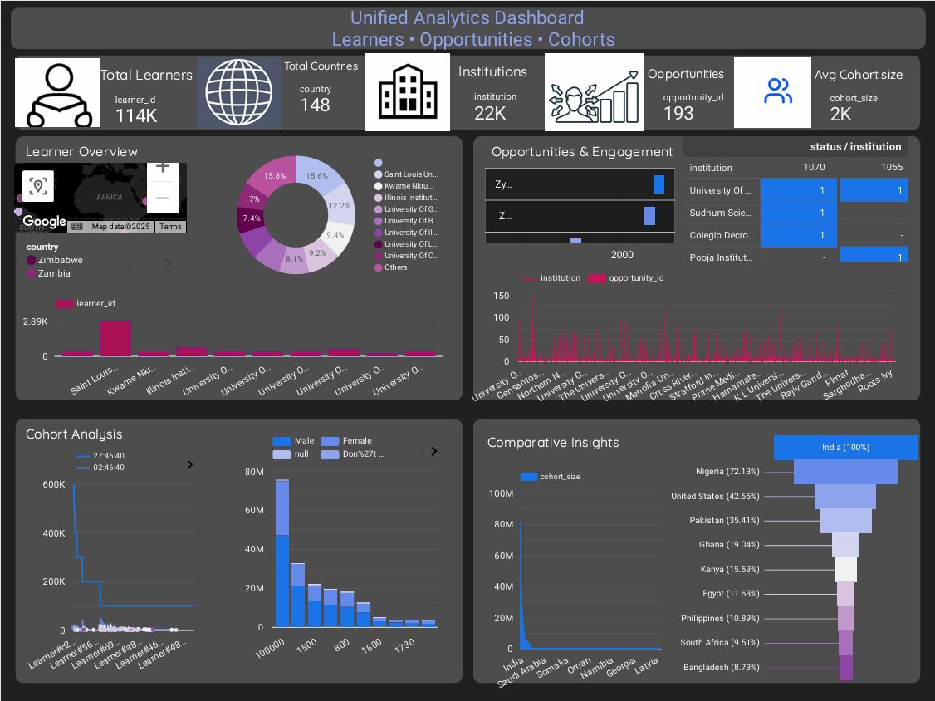
Global Learner Analytics Dashboard

Slide 17
VISUALIZATION OF MARKETING DATA
Data Collection, Data Processing & Dashboard Creation
KPIs: CTR, outbound clicks, CPR, amount spent, conversions.
Visuals:
  Bar chart
  Scatter
  Pie chart
  Line chart
Charts / Graphs
Pie/Donut – Spend Distribution (65% on 2-3)
Line Chart – CPR Trend
Scatter/Bubble – CTR vs Outbound Clicks(High CTR)
Bar Chart – Outbound Clicks by Campaign

Slide 18
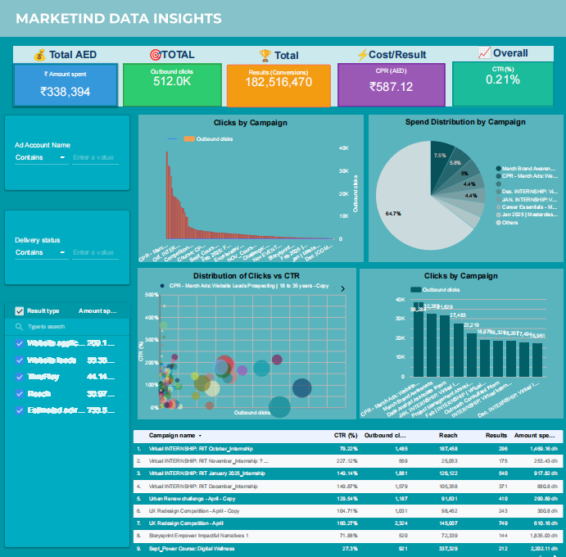
Marketing Data Insights

Slide 19
Dashboard Links
https://lookerstudio.google.com/s/oLDPiay-ZVY
https://lookerstudio.google.com/reporting/cf16186c-1200-4990-bbb2-77a9057bbd65
https://lookerstudio.google.com/reporting/bd1e9c30-e73b-4ab0-836a-074fd4c445ff
Presentation Explained Video:
https://drive.google.com/file/d/17IpcFqfwraRmaARmVuKUw4FD9Pl61Ffw/view?usp=sharing

Slide 20
THANK YOU!

